Slide 1


Sprocket Central Pty Ltd
Data analytics approach
Data Analyst - Intern

Slide 2


Agenda
Introduction
Data Exploration
Model Development
Interpretation

Slide 3

Introduction
Aim:-
Our aim is to analyze the customer datasets of Sprocket Central Pty Ltd and develop a targeted marketing strategy. Through data exploration, feature engineering, and modeling, we will identify customer segments and predict behavior. By interpreting the results and prioritizing high-value segments, we will recommend personalized marketing approaches to drive business growth. This plan will be presented in a PowerPoint presentation for client sign-off.

Slide 4
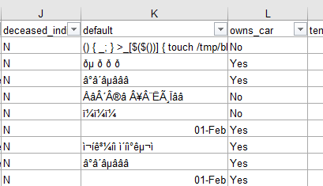
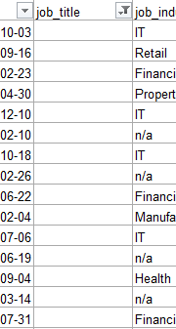
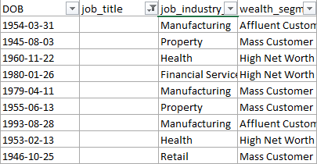
Data Exploration
Inconsistency in the data provided
After reviewing the data, I came to know that the attributes are missing of the data ( i.e., blanks ) in the records like job titles, brand of products purchased, and mismatching of data types.
And inconsistent values for the same attribute.

Slide 5

Model Development
Pre-defined record values, Modification of the attributes for better analysis
The inconsistency of the data can be optimized by providing the pre-defined data fields, so that the customer can select one of the respective category that matches him.
And instead of acquiring the date of birth attribute, consider taking the age. Similarly, consider the job titles, gender. So that the targeted customers can be found with ease and advertising can be promoted to that peer groups.

Slide 6

Interpretation
Interpreted Ideas
Considering the groups of most customers in some of the particular fields might help to expand the business at Sprocket Central Pty Ltd.
And analysing the most purchased products can help the Sprocket Central inventory maintenance easy and profitable.

Slide 7

Appendix
Contact info :
Raj Gosain
Contact: 9910062502

